Slide 1
Linguistics 200, Week 5
Day 1: Vowels

Slide 2
What we’ll doing today & next time
Vowels!
What are the properties of vowels?
How were the vowels of Metra constructed?
Creating a vowel system for Dorgon
Begin constructing your own vowel system

Slide 3
Bonus Questions
English actually has at least thirteen vowel sounds—we have just five vowel letters.
True
False
Consonants are described by three features: voicing, manner, and place. What features do vowels have?
What is the issue with having too few vowels?
The most common vowel inventory contains seven vowels.
True
False

Slide 4
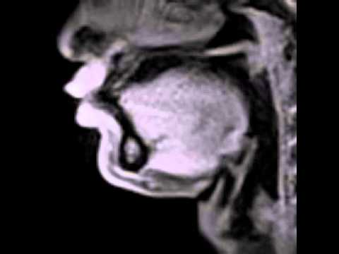

Slide 5
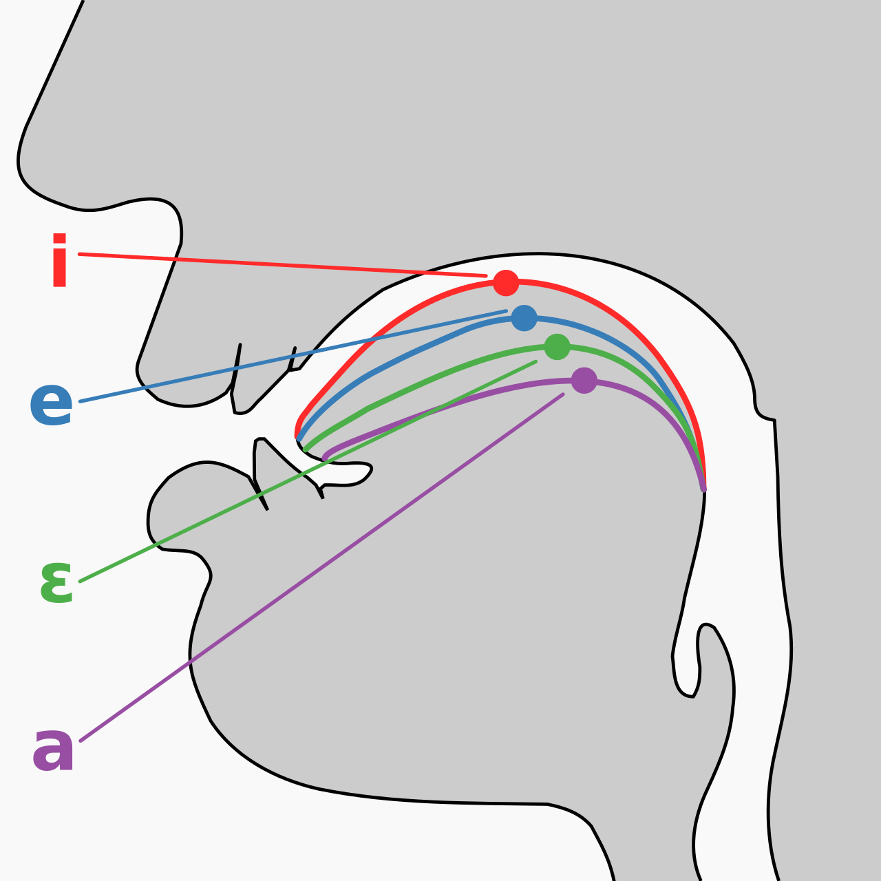
Height
Backness
Tenseness
Roundedness

Slide 6
 | Front | Central | Back
High tense lax | i ɪ |  | u ʊ
Mid tense lax | e ɛ | ʌ ə | o ɔ
Low | æ | a | ɑ
Feet
Fit

Slide 7
 | Front | Central | Back
High tense lax | i ɪ |  | u ʊ
Mid tense lax | e ɛ | ʌ ə | o ɔ
Low | æ | a | ɑ
Height
Backness
Tenseness
Roundedness

Slide 8
 | Front | Central | Back
High tense lax | i ɪ |  | u ʊ
Mid tense lax | e ɛ | ʌ ə | o ɔ
Low | æ | a | ɑ
Height
Backness
Tenseness
Roundedness
kʰip

Slide 9
 | Front | Central | Back
High tense lax | i ɪ |  | u ʊ
Mid tense lax | e ɛ | ʌ ə | o ɔ
Low | æ | a | ɑ
High
Backness
Tenseness
Roundedness

Slide 10
 | Front | Central | Back
High tense lax | i ɪ |  | u ʊ
Mid tense lax | e ɛ | ʌ ə | o ɔ
Low | æ | a | ɑ
High
Front
Tenseness
Roundedness

Slide 11
 | Front | Central | Back
High tense lax | i ɪ |  | u ʊ
Mid tense lax | e ɛ | ʌ ə | o ɔ
Low | æ | a | ɑ
High
Front
Tense
Roundedness

Slide 12
 | Front | Central | Back
High tense lax | i ɪ |  | u ʊ
Mid tense lax | e ɛ | ʌ ə | o ɔ
Low | æ | a | ɑ
High
Front
Tense
Unrounded

Slide 13
 | Front | Central | Back
High tense lax | i ɪ |  | u ʊ
Mid tense lax | e ɛ | ʌ ə | o ɔ
Low | æ | a | ɑ
Height
Backness
Tenseness
Roundedness
kʰʌt

Slide 14
 | Front | Central | Back
High tense lax | i ɪ |  | u ʊ
Mid tense lax | e ɛ | ʌ ə | o ɔ
Low | æ | a | ɑ
Height
Backness
Tenseness
Roundedness
kʰʊk

Slide 15
 | Front | Central | Back
High tense lax | i ɪ |  | u ʊ
Mid tense lax | e ɛ | ʌ ə | o ɔ
Low | æ | a | ɑ
Height
Backness
Tenseness
Roundedness
kʰæt

Slide 16
Designing your vowel system
What is the smallest vowel system you can have?

Slide 17
Designing your vowel system
 | Front | Central | Back
High tense lax | i |  | u
Mid tense lax
Low |  | a
What is the smallest vowel system you can have?

Slide 18
Designing your vowel system
Which types of languages tend to have fewer vowels?

Slide 19
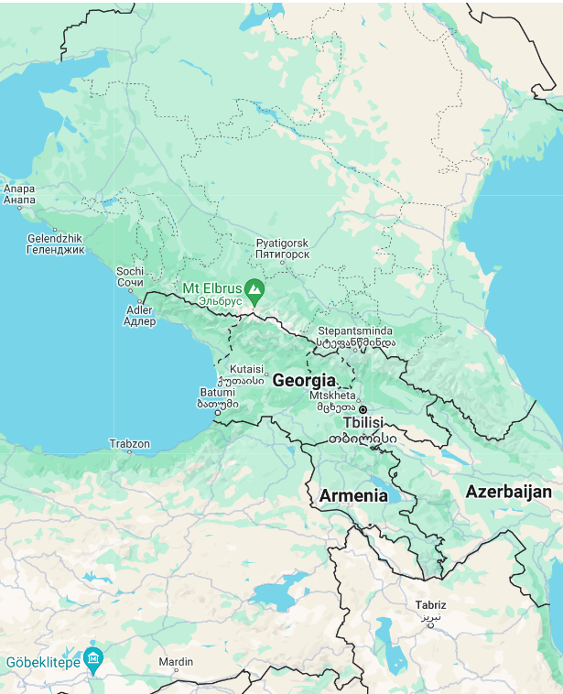
Designing your vowel system
Which types of languages tend to have fewer vowels?

Slide 20
Designing your vowel system
How does the “elevator” metaphor help you in your vowel system’s design?

Slide 21
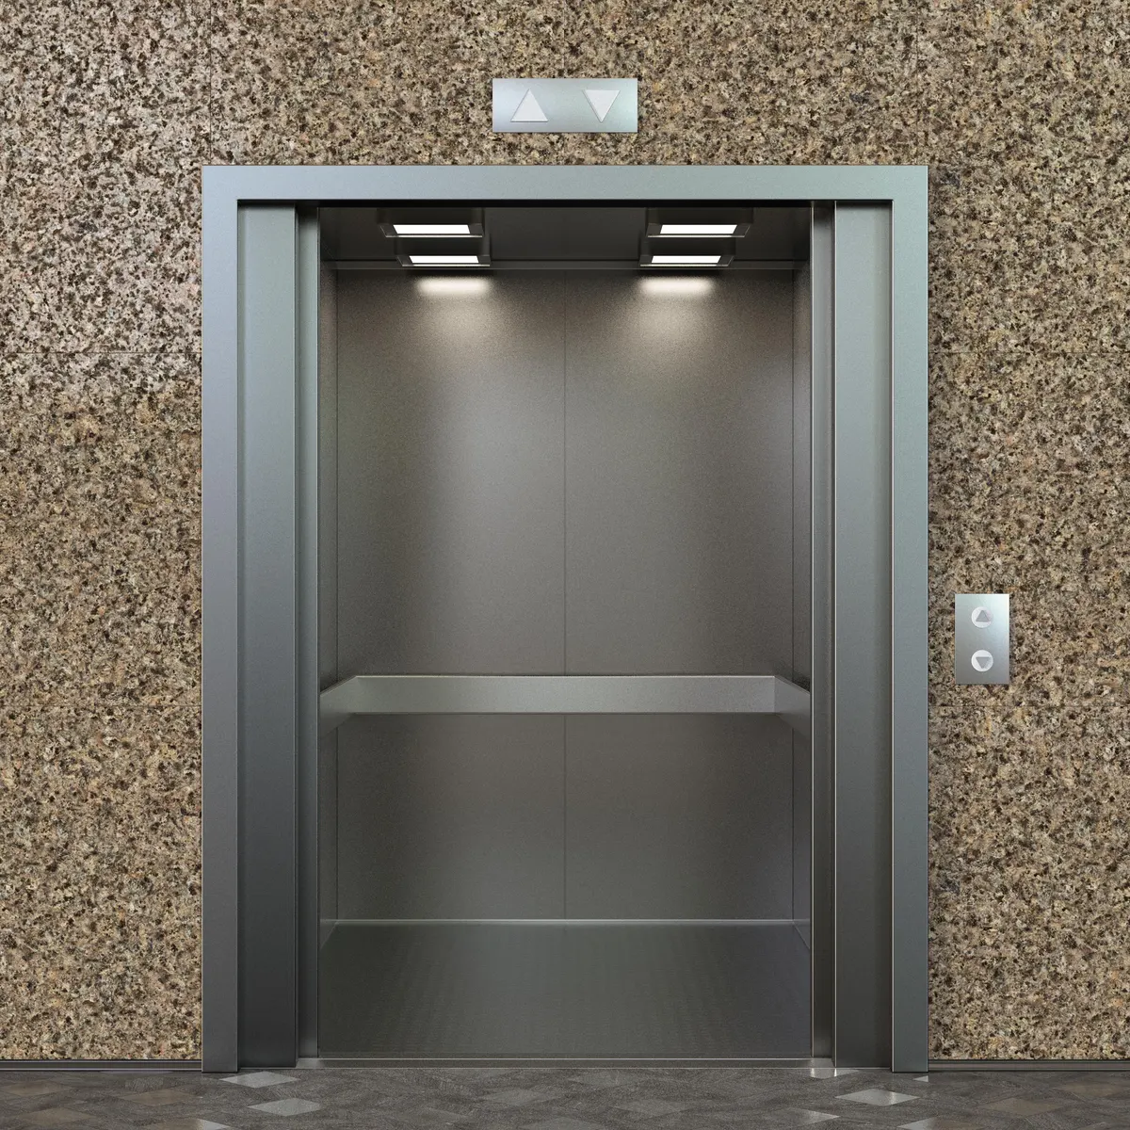
Designing your vowel system
How does the “elevator” metaphor help you in your vowel system’s design?

Slide 22
Designing your vowel system
Easy ways to make your system "non-English"

Slide 23
Designing your vowel system
 | Front | Central | Back
High tense lax | i ɪ |  | u ʊ
Mid tense lax | e ɛ | ʌ ə | o ɔ
Low | æ | a | ɑ
Easy ways to make your system "non-English"

Slide 24
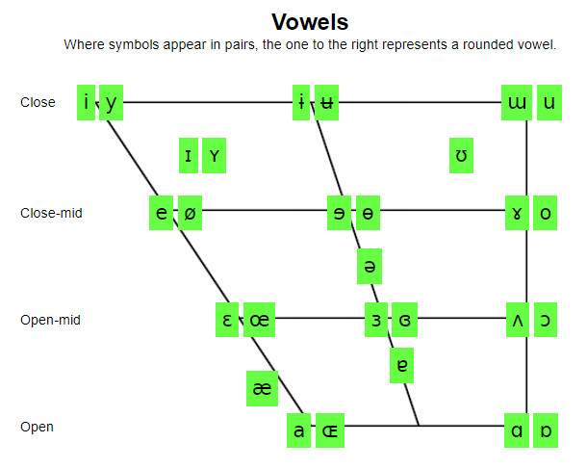

Slide 26
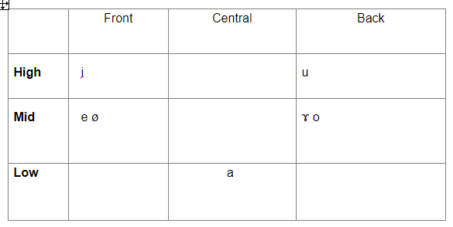
Metra Vowels

Slide 27
Dorgons – Let's make a vowel system
What words do we already have from Elijah?
Zenasath [ˈzinəsæθ]
Cindor [ˈsɪndɔɹ]
Kdasion [ˈkdæsiɑn]
Dorgon [ˈdɔɹgɑn]
Galasiul [gəˈlæsiəɫ]
Gzenian [ˈgzɛniɑn]
Dumbledimpf [ˈdʌmbl̩dɪmpf]
(note: these word have an American English pronunciation – we’ll need to modify them to produce an original language!)
Which vowels are particularly Englishy? (Think about your own language experiences)

Slide 28
Dorgons – Let's make a vowel system
What words do we already have from Elijah?
Zenasath [ˈsinəsæθ]
Cindor [ˈsɪndɔɹ]
Kdasion [ˈkdæsiɑn]
Dorgon [ˈdɔɹgɑn]
Galasiul [gəˈlæsiəɫ]
Gzenian [ˈgzɛniɑn]
Dumbledimpf [ˈdʌmbl̩dɪmpf]
(note: these word have an American English pronunciation – we’ll need to modify them to produce an original language!)
Which vowels (or vowel-like things) are particularly Englishy? (Think about your own language experiences)

Slide 29
Dorgon Words
Less-English sounding words
Zenasath [ˈsenasaθ]
Cindor [ˈsindoɹ]
Kdasion [ˈkdasian]
Dorgon [ˈdoɹgan]
Galasiul [gaˈlasiul]
Gzenian [ˈgzenian]
Dumbledimpf [ˈdumbaldimpf]

Slide 30
For next time
Draw up a vowel chart
Plot your 3 favorite non-English vowels
Find your names that you've already constructed – what vowels are in them?
Add basic vowels
Eliminate vowels that sound too similar, or that you have a hard time pronouncing
Simplify & balance your system, if needed

Slide 31
Linguistics 200, Week 5
Day 2: Vowels, Phonotactics

Slide 32
Today
Finish Vowel system
Syllables / Phonotactics
For class credit:
Subdivide your sounds into different groups (see slide 57)

Slide 33
Bonus Questions
What is a syllable? How does a syllable compare to, say, a consonant?
Japanese is unique in that it has restrictions on how their words and syllables are pronounced.
True
False
Say out loud “Fneischel”. How can you tell this is not an English word?
Consider the following words. Why do or don’t they seem like they could be English?
Hraind
Farp
Txai

Slide 34
What are syllables?
σ

Slide 35
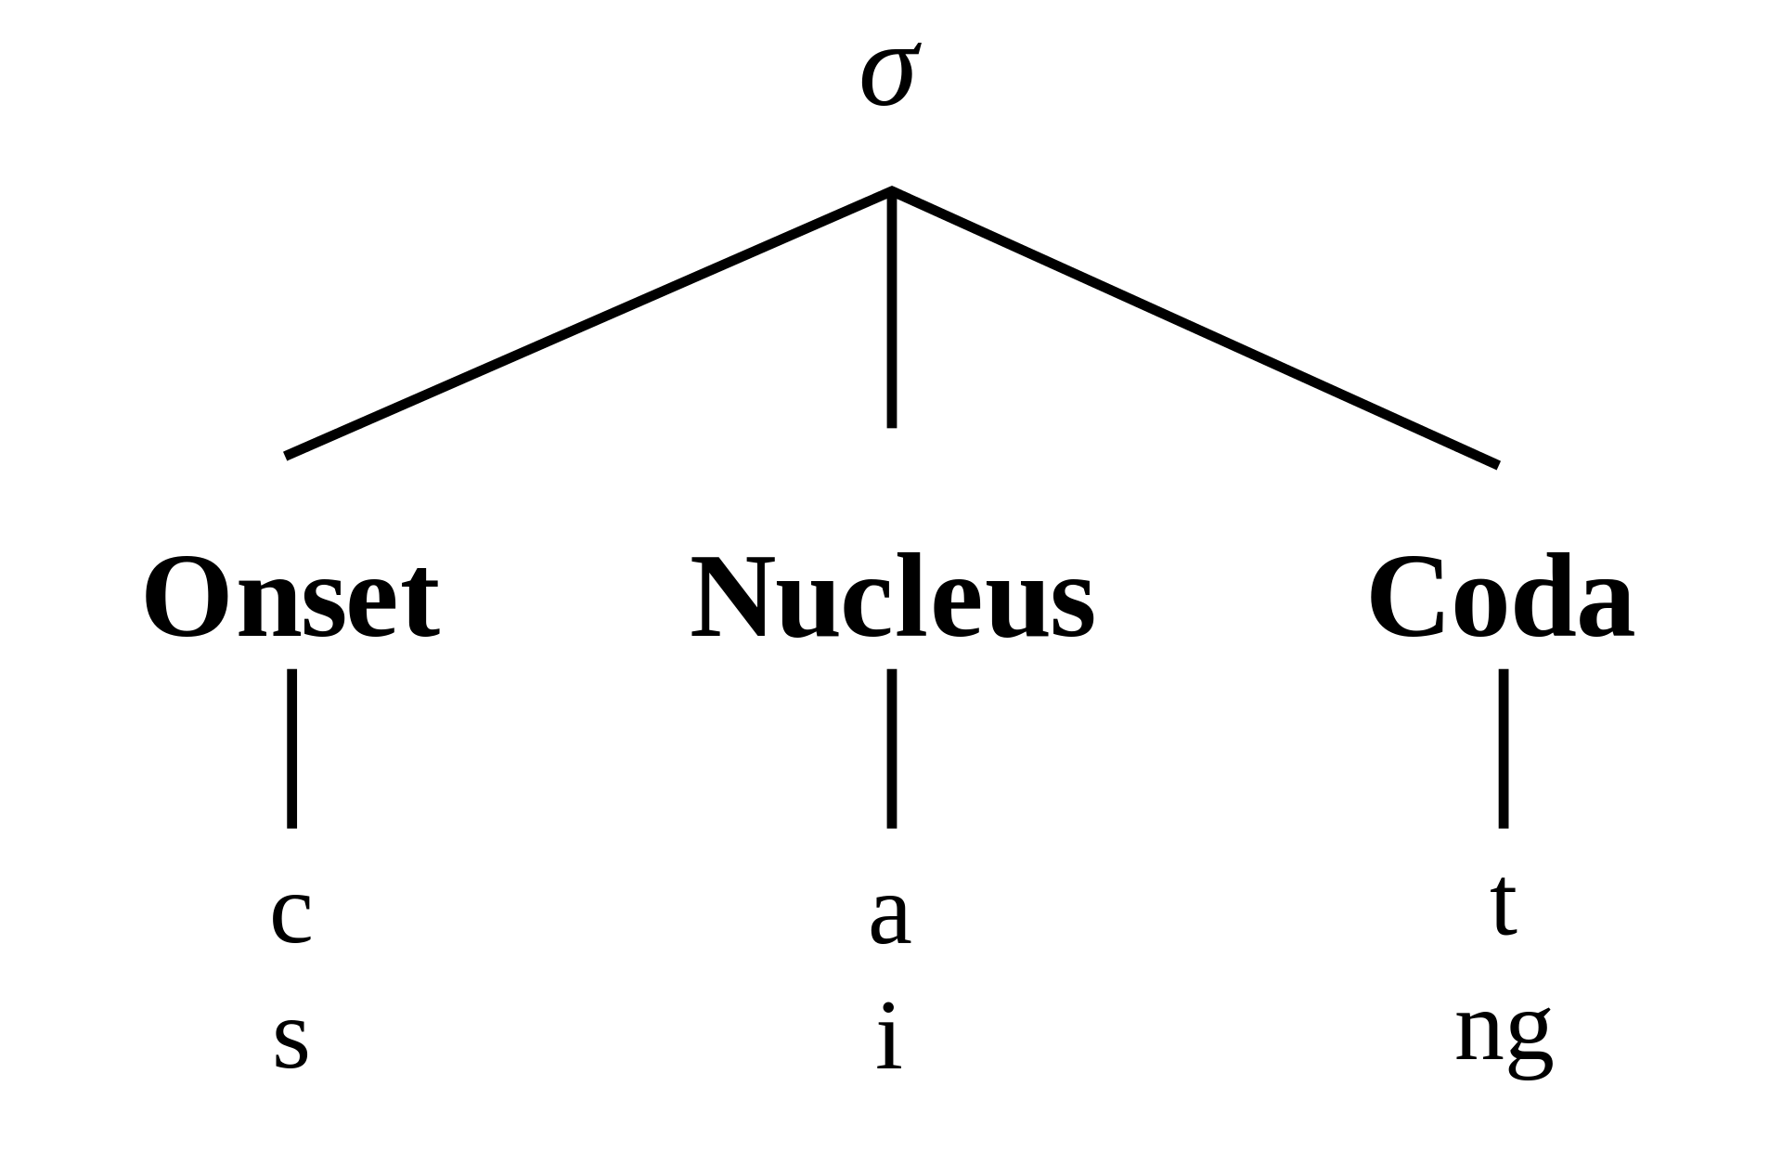

Slide 36
Hawaiian
https://hawaiian-words.com/common/

Slide 37
Hawaiian
Akua
Ala
Alelo
Ali‘i
Aloha
Aloha ‘auinalā
Aloha ‘oe
Aloha ahiahi

Slide 38
Hawaiian
Akua
Ala
Alelo
Ali‘i
Aloha
Aloha ‘auinalā
Aloha ‘oe
Aloha ahiahi
(C)V

Slide 39
Japanese
https://www.transparent.com/learn-japanese/phrases.html

Slide 40
Japanese
Sumimasen. Excuse me.
すみません。
Gomennasai. I am sorry.
ごめんなさい。
Ohayō gozaimasu. Good morning.
おはようございます。
Konbanwa. Good evening.
こんばんは。
O-yasumi nasai. Good night.
おやすみなさい。
Hai. Yes.
はい。
Iie. No.
いいえ。
O-negai shimasu. Please.
おねがいします。
Arigatō. Thank you.
ありがとう。
Dōitashimashite. You're welcome.
どういたしまして。

Slide 41
Japanese
Sumimasen. Excuse me.
すみません。
Gomennasai. I am sorry.
ごめんなさい。
Ohayō gozaimasu. Good morning.
おはようございます。
Konbanwa. Good evening.
こんばんは。
O-yasumi nasai. Good night.
おやすみなさい。
Hai. Yes.
はい。
Iie. No.
いいえ。
O-negai shimasu. Please.
おねがいします。
Arigatō. Thank you.
ありがとう。
Dōitashimashite. You're welcome.
どういたしまして。
(C)V(N)
(C)V(C₁C₁V)

Slide 42
Spanish
https://www.rosettastone.com/spanish-words/

Slide 43
Spanish
Buenos días / Good morning
Buenas tardes / Good afternoon
Buenas noches / Good evening
Hola, me llamo Juan / Hello, my name is John
Me llamo… / My name is…
¿Cómo te llamas? / What’s your name?
Mucho gusto / Nice to meet you
¿Cómo estás? / How are you?
Estoy bien, gracias / I’m well thank you
Disculpa. ¿Dónde está el baño? / Excuse me. Where is the bathroom?
¿Qué hora es? / What time is it?
¿Cómo se dice ‘concert’ en español? / How do you say ‘concert’ in Spanish?
Estoy perdido/a / I am lost
Yo no comprendo / I do not understand
Por favor, habla más despacio / Would you speak slower, please
Te extraño / I miss you
Te quiero / I love you

Slide 44
Spanish
(CL)V(s)
Buenos días / Good morning
Buenas tardes / Good afternoon
Buenas noches / Good evening
Hola, me llamo Juan / Hello, my name is John
Me llamo… / My name is…
¿Cómo te llamas? / What’s your name?
Mucho gusto / Nice to meet you
¿Cómo estás? / How are you?
Estoy bien, gracias / I’m well thank you
Disculpa. ¿Dónde está el baño? / Excuse me. Where is the bathroom?
¿Qué hora es? / What time is it?
¿Cómo se dice ‘concert’ en español? / How do you say ‘concert’ in Spanish?
Estoy perdido/a / I am lost
Yo no comprendo / I do not understand
Por favor, habla más despacio / Would you speak slower, please
Te extraño / I miss you
Te quiero / I love you
(CL)V(L)
(CL)V(N)

Slide 45
Linguistics 200, Week 5
Day 3: Phonotactics

Slide 46
Review
You've made your C & V systems
We began talking about phonotactics
"how you're allowed to put your sounds together"
All about syllables
What was the syllable structure of:
Hawaiian?
Japanese?
Spanish?

Slide 47
English
https://www.dictionary.com/e/common-words/

Slide 48
English
do: accomplish, prepare, resolve, work out
say: suggest, disclose, answer
go: continue, move, lead
get: bring, attain, catch, become
make: create, cause, prepare, invest
know: understand, appreciate, experience, identify
think: contemplate, remember, judge, consider
take: accept, steal, buy, endure
see: detect, comprehend, scan
come: happen, appear, extend, occur
want: choose, prefer, require, wish
look: glance, notice, peer, read
use: accept, apply, handle, work
find: detect, discover, notice, uncover
give: grant, award, issue
tell: confess, explain, inform, reveal

Slide 49
English
do: accomplish, prepare, resolve, work out
say: suggest, disclose, answer
go: continue, move, lead
get: bring, attain, catch, become
make: create, cause, prepare, invest
know: understand, appreciate, experience, identify
think: contemplate, remember, judge, consider
take: accept, steal, buy, endure
see: detect, comprehend, scan
come: happen, appear, extend, occur
want: choose, prefer, require, wish
look: glance, notice, peer, read
use: accept, apply, handle, work
find: detect, discover, notice, uncover
give: grant, award, issue
tell: confess, explain, inform, reveal
(s)(C)(R)V(C)(C)

Slide 50
Polish
https://www.inyourpocket.com/warsaw/the-polish-language-co-za-bzdura_74022f

Slide 51
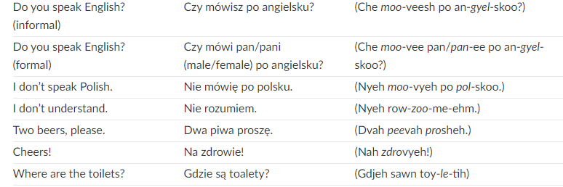
Polish

Slide 52
Polish
CCRVs/L/N

Slide 53
Georgian
https://www.17-minute-world-languages.com/en/georgian/

Slide 54
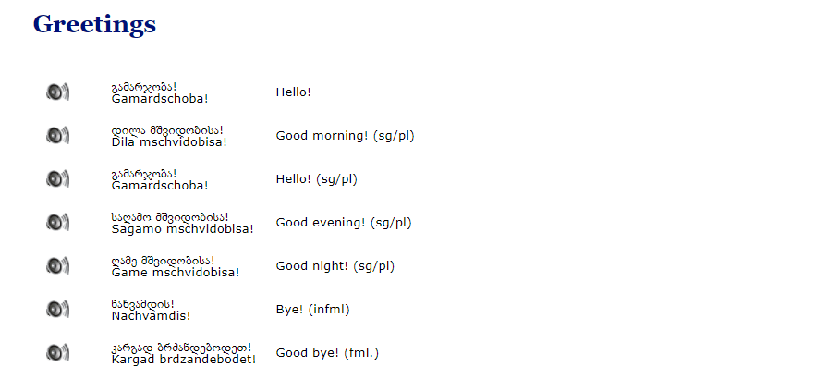
Georgian

Slide 55
Georgian
!!!!!
!!!!!!!!!!!!!!!!!

Slide 56
Georgian
gvprtskvni “you peeled us (like a potato)”

Slide 57
Identifying your phonotactics
Let’s begin by subdividing your sounds into different groups:
C = all consonants (so, p/t/k)
V = all vowels
P = stops
F = Fricatives
O = Stops, Fricatives, Affricates
N = Nasals R = Nasals, Liquids, Glides
L = Liquids H = Fricatives + R
G = Glides
Use the IPA symbols
Separate sounds with /
You might have other categories!!! (affricates, implosives, etc.)

Slide 58
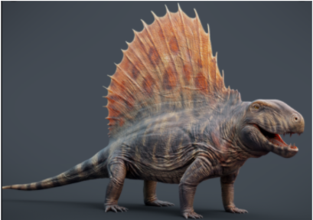
Metra Phonology

Slide 59
 | Bilabial | Alveolar | Retroflex | Palatal | Velar | Uvular
Stop voiceless implosive | p ɓ | t ɗ |  |  | k ɠ | q ʛ
Nasal | m | n |  |  | ŋ | ɴ
Fricative voiceless voiced |  | s |  | ç | x ɧ ɣ
Glide | w |  |  | j
Liquid |  |  | ɭ |  |  | ʀ

Slide 60
 | Front | Central | Back
High | i |  | u
Mid | e ø |  | ɤ o
Low |  | a

Slide 61
C = p/t/k/q/ɓ/ɗ/ɠ/ʛ/s/ç/x/ɧ/ɣ/m/n/ŋ/ɴ/w/y/ɭ/ʀ
P = p/t/k/q/ɓ/ɗ/ɠ/ʛ
F = s/ç/x/ɧ/ɣ
O = p/t/k/q/ɓ/ɗ/ɠ/ʛ/s/ç/x/ɧ/ɣ
N = m/n/ŋ/ɴ
G = w/y
L = ɭ/ʀ
V = i/u/e/ø/ɤ/o/a
R = m/n/ŋ/ɴ/w/y/ɭ/ʀ
H = s/ç/x/ɧ/ɣ/m/n/ŋ/ɴ/w/y/ɭ/ʀ

Slide 62
Identifying your phonotactics
https://susurrus-llc.github.io/langua/gen/

Slide 63
Identifying your phonotactics
Make your language like:
Hawaiian CV 4) English (F)(C)(R)V(C)(C)
Japanese (C)V(N) 5) Polish (C)(C)(R)V(H)
Spanish (C)(R)V(R) 6) Georgian (C)(C)(C)(C)(C)(C)(C)(C)(C)V(C)
*For each time you run the website, copy and paste the words that are generated into your google doc.
*Feel free to be more specific in your categories, thus C could be O, R, F, etc.
*Play with the word generator until you find a phonotactic structure you like.

Slide 64
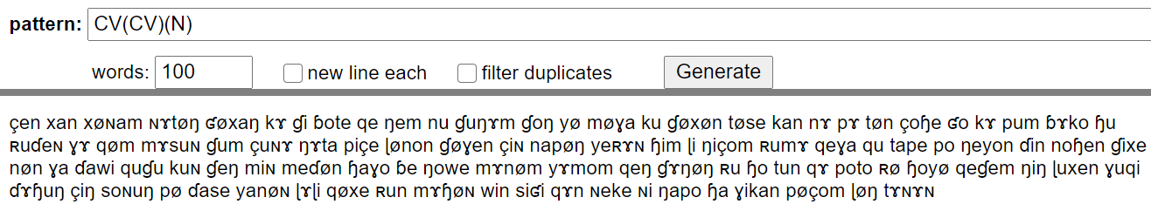
Finally - Name your language
Mɤɧøɴ!

Slide 65
Dorgon Phonology
Classic 5-vowel system
 | Bilabial | Interdental | Alveolar | Palatal | Velar
Stop | p b |  | t d | c ɟ | k g
Nasal | m |  | n | ɳ | ŋ
Affricate | pf |  | ts
Fricative |  | θ (ð) | s (z) | ç (ʝ) | x (ɣ)
Liquid |  |  | r, l

Slide 66
Let's do this for Dorgon
Let’s begin by subdividing your sounds into different groups:
C = all consonants (so, p/t/k)
V = all vowels
P = all stops
A = affricates
F = Fricatives
O = Stops, Fricatives, Affricates
N = Nasals R = Nasals, Liquids
L = Liquids H = Fricatives + R

Slide 67
Let's do this for Dorgon
Let’s begin by subdividing your sounds into different groups:
C =
V = a/e/i/o/u
P = p/t/c/k/b/d/ɟ/g
A = pf/ts
F = θ/s/ç/x
O = p/t/c/k/b/d/ɟ/g/pf/ts/θ/s/ç/x
N = m/n/ɳ/ŋ R = r/l/m/n/ɳ/ŋ
L = r/l H = θ/s/ç/x/r/l/m/n/ɳ/ŋ

Slide 68
What do we know about Dorgon Phonotactics?
What is allowed?
In codas? Are all sounds allowed?
In onsets? Are all sounds allowed?
Are there any syllables that don't have an onset?
In consonant sequences? Are two or more consonants allowed in the onset, coda?
Zenasath [ˈsinasaθ]
Cindor [ˈsindoɹ]
Kdasion [ˈkdasian]
Dorgon [ˈdoɹgan]
Galasiul [gaˈlasiul]
Gzenian [ˈgzenian]
Dumbledimpf [ˈdumbaldimpf]

Slide 69
Now it's your turn!

Slide 70
Testing your language’s sound
http://ipa-reader.xyz/

